Slide 1
My Project
By: Szebelédi Zoltán

Slide 2
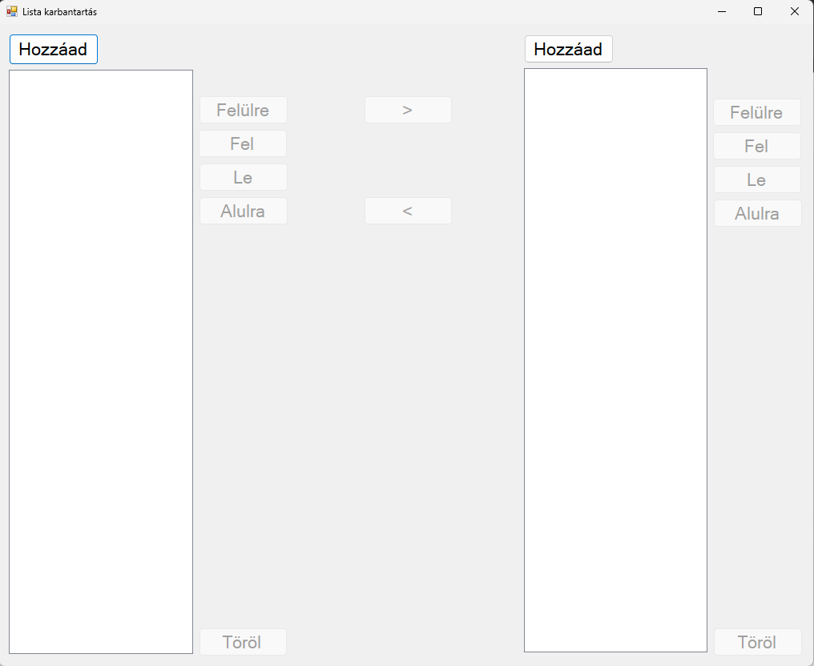
Main Page
You can add or delete as many items (maximum 3 words) to the 2 list each as many you want
You can reorder the 2 list how you want them
You can switch the items between the 2 list

Slide 3
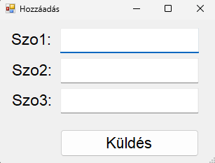
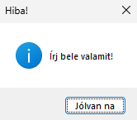
Add Page
You don’t have to add all 3 just minimum 1
You can’t leave them all blank

Slide 4
Thank you for listening
That’s All Folks

